Slide 1

Between-Groups ANOVA
Chapter 12

Slide 2
Quick Test Reminder
One person = Z score
One sample with population standard deviation = Z test
One sample no population standard deviation = single t-test
One sample test twice = paired samples t
Two samples = independent t

Slide 3
Quick Distributions Reminder
Z = Distribution of scores
Z = distribution of means (for samples)
t = distribution of means (for samples with estimated standard deviation)
t = distribution of mean differences (for paired samples with estimated standard deviation)
t = distribution of differences between means (for two groups independent t)

Slide 5
So what now?
We could do lots of pairwise t-tests
Group 1 versus Group 2
Group 1 versus Group 3
Group 2 versus Group 3
(that’s too easy though)

Slide 6
Why not use multiple t-tests?
The problem of too many t tests
Fishing for a finding
Problem of Type I error (alpha)
New type 1 error rate = 1 – (1-alpha)^{c}
We want type 1 error rate to stay at .05

Slide 7
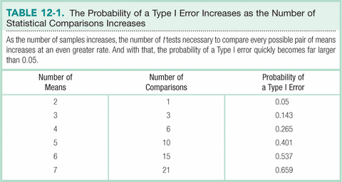

Slide 8
So what do we do?
When to use an F distribution
Working with more than two samples
ANOVA
Analysis of Variance
Used with two or more nominal independent variables and an interval/ratio dependent variable

Slide 9
Types of ANOVA
One-Way: hypothesis test including one nominal variable with more than two levels and a scale DV
Within-Groups: more than two samples, with the same participants; also called repeated-measures
Between-Groups: more than two samples, with different participants in each sample

Slide 10
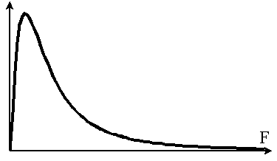
The F distribution

Slide 11
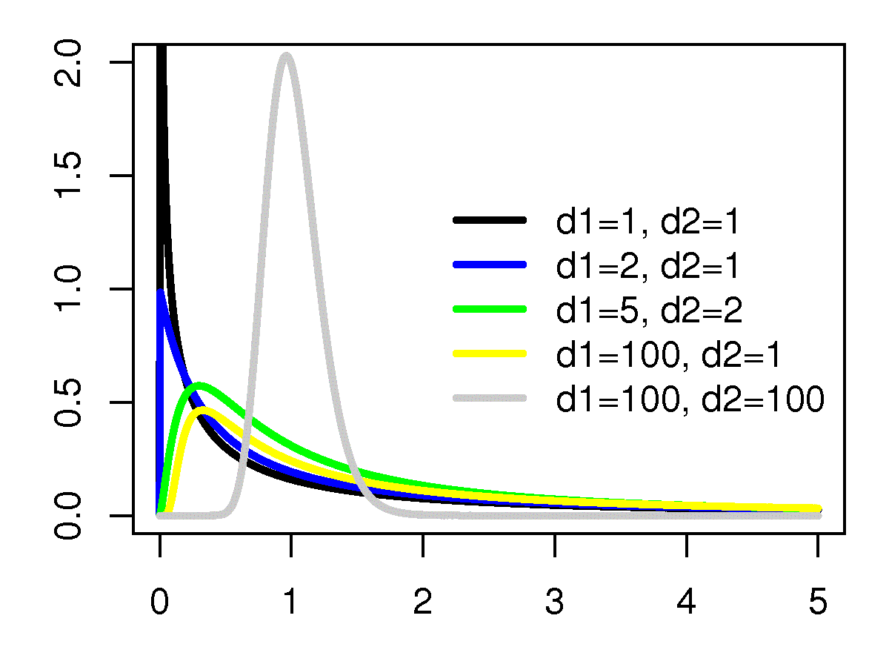
The F distribution

Slide 12
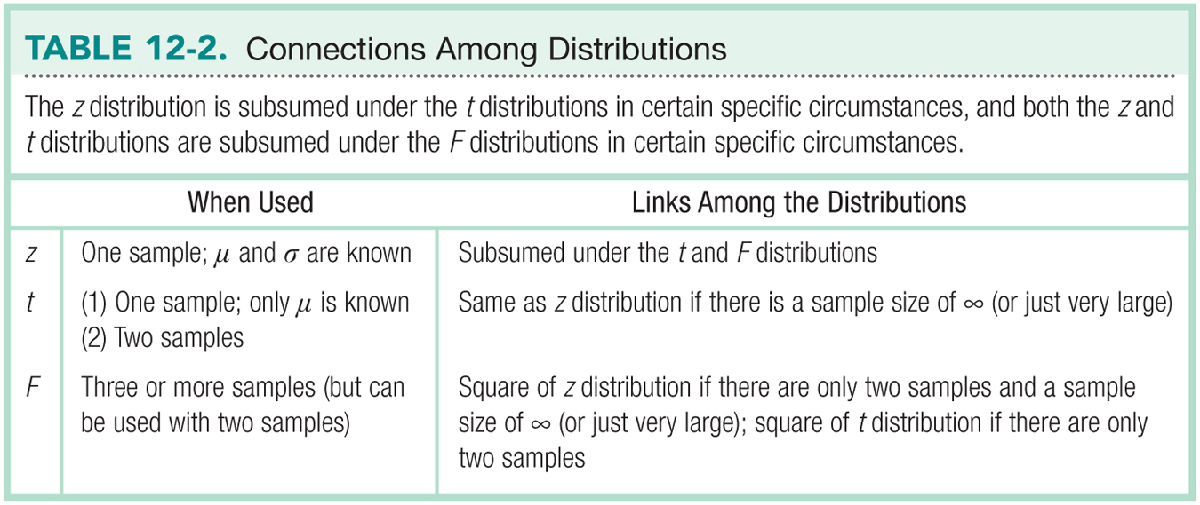

Slide 13
Let’s talk about test statistics
Test type | Formula
Z | M – μ_{M} σ_{M}
Single t | M – μ_{M} s_{M}
Paired t | M s_{M}
Independent t | M – M s_{difference}
Now what do we do with 3 or more Ms and SDs?

Slide 14
The F Distribution
Analyzing variability to compare means
F = variance between groups
variance within groups
That is, the difference among the sample means divided by the average of the sample variances

Slide 15
Logic behind the F Statistic
Quantifies overlap
Two ways to estimate population variance
Between-groups variability
Within-groups variability

Slide 16
Types of Variance
Between groups: estimate of the population variance based on differences among group means
Within groups: estimate of population variance based on differences within (3 or more) sample distributions

Slide 17
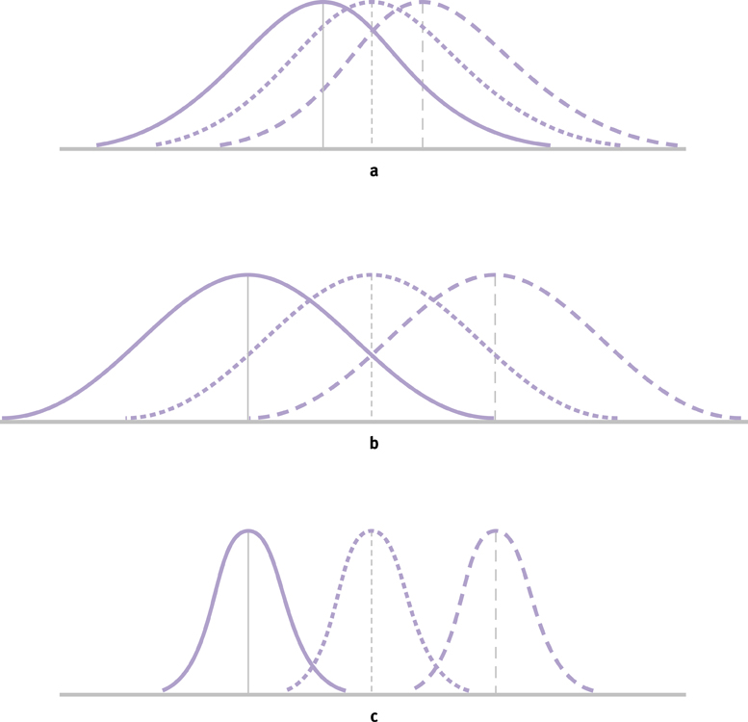
The Logic of ANOVA

Slide 18
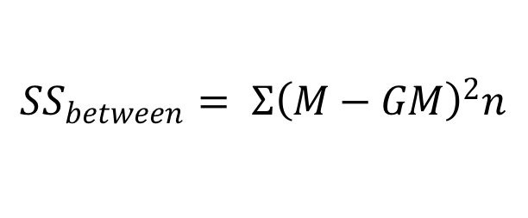
Formulae
$${SS}_{between}= Σ{\left(M−GM\right)}^{2}n$$

Slide 19
The Source Table
Presents important calculations and final results in a consistent, easy-to-read format

Slide 20
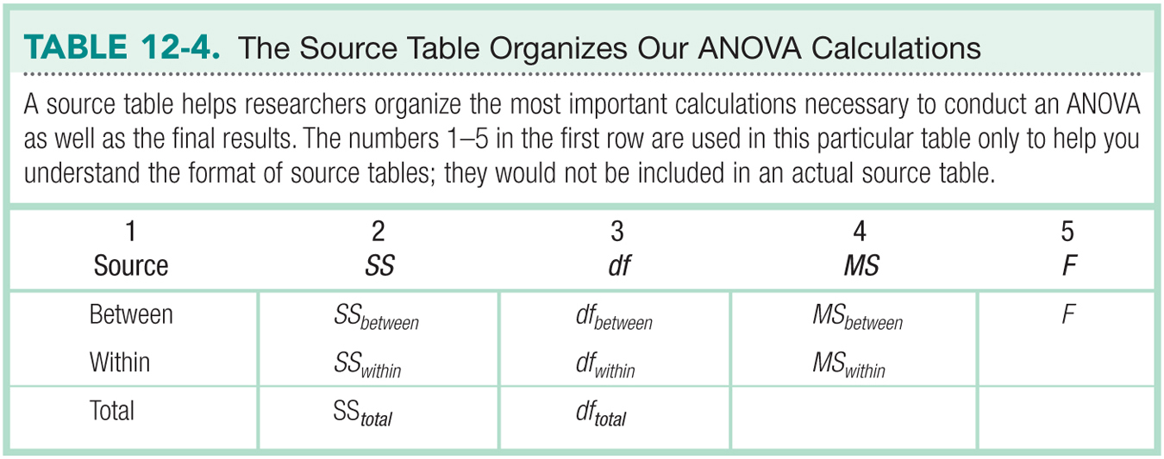

Slide 21
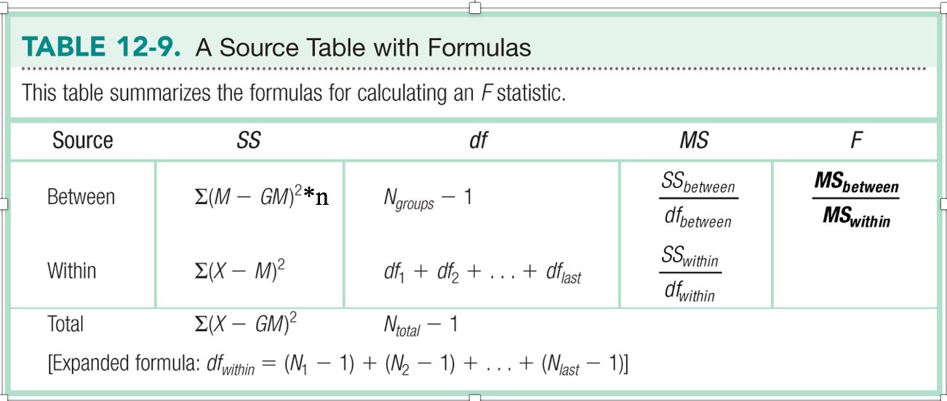

Slide 22
Sum of Squares Example
Let’s try calculating SS within and SS between.
Load the chapter 12 data in R.

Slide 23
Sum of Squares Example
Let’s try SS total
Each person minus grand mean, squared, and summed.
The logic here is overall variance, both due to your IV and error will be calculated.

Slide 24
Sum of Squares Example
mean(unlist(chapter12))
sum((chapter12 - 4.7)^2)
96.3

Slide 25
Sum of Squares Example
SS within:
The difference of each person minus their group mean, squared.
That’s the top half of the variance equation.
The logic here is that we don’t know why people differ within their own group, so it’s considered error.

Slide 26
Sum of Squares Example
summary(chapter12)
sum((chapter12$cheese - 6.3)^2)
sum((chapter12$candy - 2.7)^2)
sum((chapter12$fruit - 5.10)^2)
8.1+8.1+12.9 = 29.1 within SS

Slide 27
Sum of Squares Example
SS between
Each group minus the grand mean, squared, times n, and totaled.
Why times n? Every other formula is for each person, so we need to do this one for each person as well.
The logic here is to measure how much of the overall variance is IV group differences, not individual differences.

Slide 28
Sum of Squares Example
(6.3 - 4.7)^2 *10 +
(2.7 - 4.7)^2 *10 +
(5.1 - 4.7)^2 *10
67.2

Slide 29
Variance Type | SS | df | MS | F
Between groups (IV) | 67.2
Within Groups (error) | 29.1
Total | 96.3

Slide 30
Let’s talk about df
Test type | df
Single sample | N – 1
Paired samples t | N – 1
Independent t | N – 1 + N – 1

Slide 31
Degrees of Freedom for ANOVA

Slide 32
Variance Type | SS | df | MS | F
Between groups (IV) | 67.2 | 2
Within Groups (error) | 29.1 | 27
Total | 96.3 | 29

Slide 33
Variance Type | SS | df | MS | F
Between groups (IV) | 67.2 | 2 | DIVIDE! 33.6
Within Groups (error) | 29.1 | 27 | 1.08
Total | 96.3 | 29 | XX

Slide 34
Variance Type | SS | df | MS | F
Between groups (IV) | 67.2 | 2 | 33.6 | DIVIDE! 31.11
Within Groups (error) | 29.1 | 27 | 1.08 | XX
Total | 96.3 | 29 | XX | XX

Slide 35
One-Way Between-Groups ANOVA
Everything about ANOVA but the calculations
1. Identify the populations, distribution, and assumptions.
2. State the null and research hypotheses.
3. Determine the characteristics of the comparison distribution.
4. Determine the critical value, or cutoff.
5. Calculate the test statistic.
6. Make a decision.

Slide 36
Assumptions of ANOVAs
Random selection of samples
Normally distributed sample
DV is scale
Homoscedasticity: samples come from populations with the same variance
Generally this is referred to as homogeneity

Slide 37
Step 2
Label all the sample groups
ONLY us = and =/
Why?

Slide 38
Step 2
R: cheese =/ candy =/ fruit
N: cheese = candy = fruit

Slide 39
Step 3
Here we want to calculate the means, so we know what we are comparing.
Then calculate the ANOVA summary table.

Slide 40
Step 3
To get the means:
summary(dataset)
To get the ANOVA table:
Restructure the data
Add a participant number
Run ezANOVA

Slide 41
Step 3
Restructure the data from wide to long format.
Use the reshape library (NOT reshape2)
longdata = melt(dataset,
measured = c(“column”, column”…)

Slide 42
Step 3
Add a participant number:
longdata$partno = 1:nrow(longdata)

Slide 43
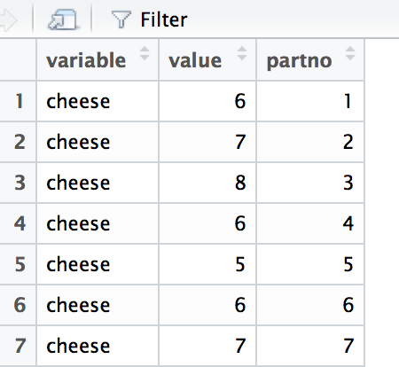
Step 3
NOTE:
Reshape changes the names of the columns
Variable = group, your IV
Value = score, your DV

Slide 44
Step 3
Run ezANOVA to get your ANOVA.
ezANOVA(data = dataset,
dv = value,
between = variable,
wid = partno,
type = 3,
return_aov = T)

Slide 45
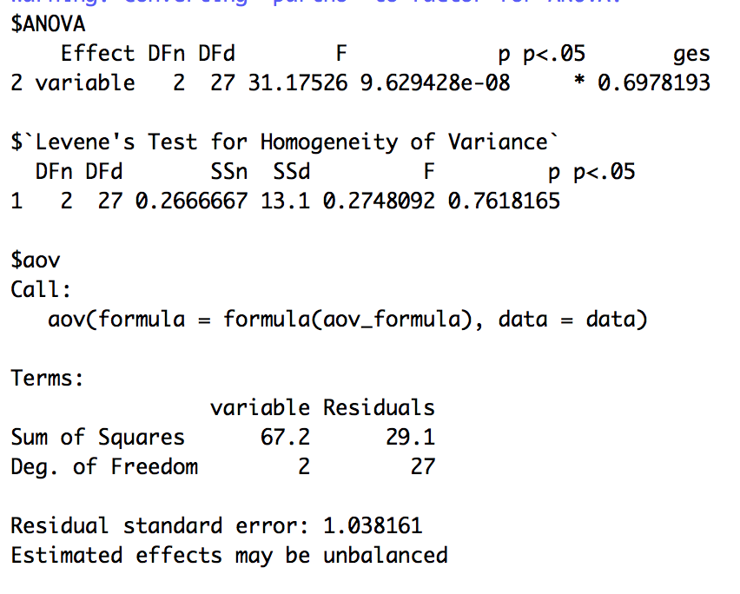
Step 3

Slide 46
Step 4
Calculate the F critical?
qf(.05, df bn, df wn, lower.tail = F)
qf(.05, 2, 27, lower.tail = F)
Don’t change lower.tail
No / 2 since always one tailed

Slide 47
Step 5
Use F from the source table.

Slide 48
Step 6
Is F found in step 5 > F critical in step 4?
Reject null
If not:
Fail to reject null

Slide 49
Calculating Effect Size
Amount of
variance due to
the IV out of the total.
R² is a common measure of effect size for ANOVAs.
67.2 / 96.3 = .70
Or use the ges column.
Only 0-1, it is a proportion.

Slide 50
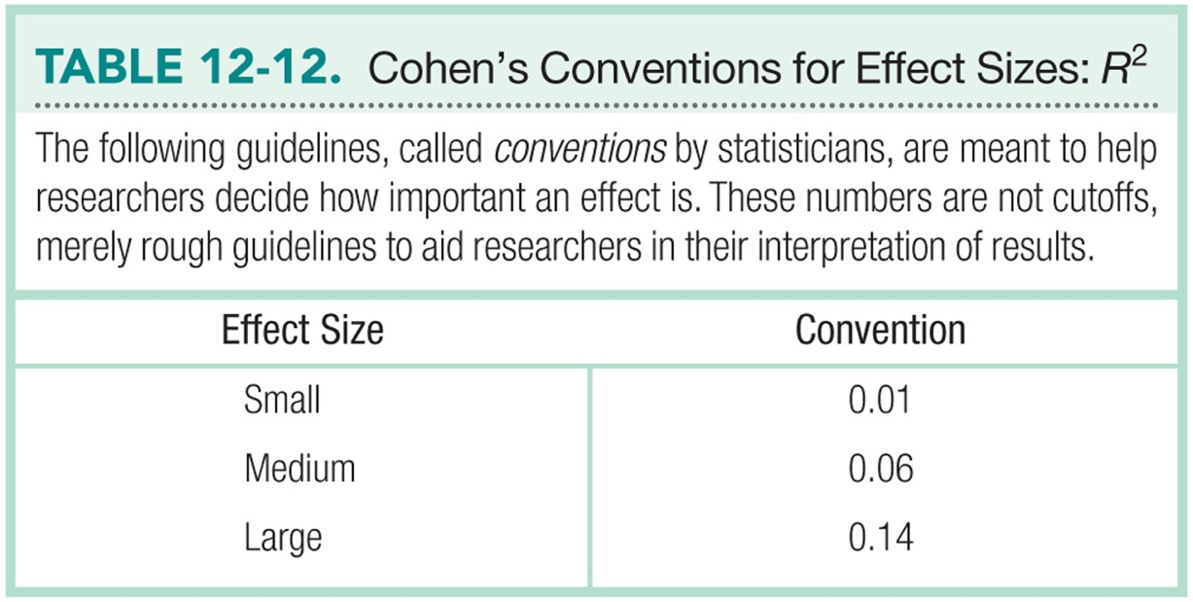

Slide 51
Post-Hoc Tests to Determine Which Groups Are Different
When you have three groups, and F is significant, how do you know where the difference(s) are?
Run a post hoc test
Run a post hoc correction
Bonferroni
(other types: Tukey, Scheffe)

Slide 52
Important Programming Note
Post hoc tests
Independent t because it matches the type of research design (between subjects ANOVA = between groups = independent t)
Post hoc corrections
Solve our type 1 error problem

Slide 53
The Bonferroni Test
A post-hoc correction on a test that provides a more strict critical value for every comparison of means.
We use a smaller critical region to make it more difficult to reject the null hypothesis.
Determine the number of comparisons we plan to make.
Divide the alpha (p<.05, p<.01) level by the number of comparisons.

Slide 54
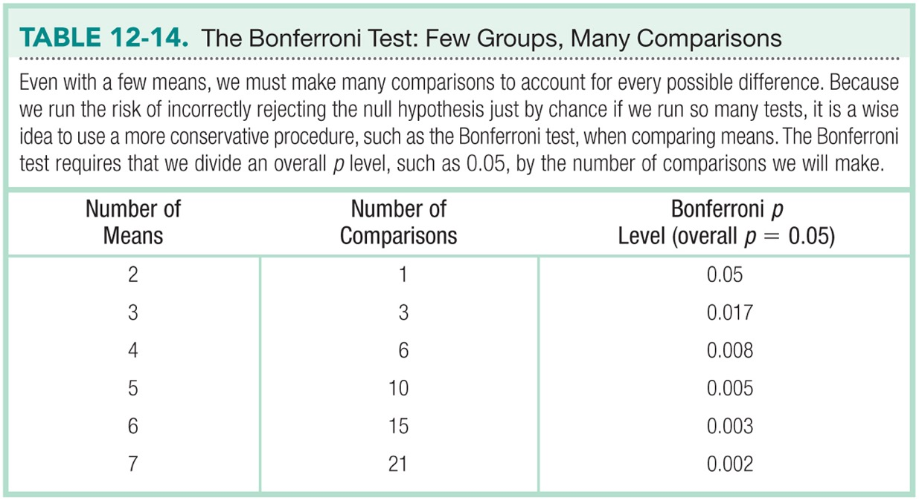

Slide 55
Bonferroni in R
pairwise.t.test(longdata$value, longdata$variable,
paired = F,
var.equal = T,
p.adjust.method = "bonferroni")

Slide 56
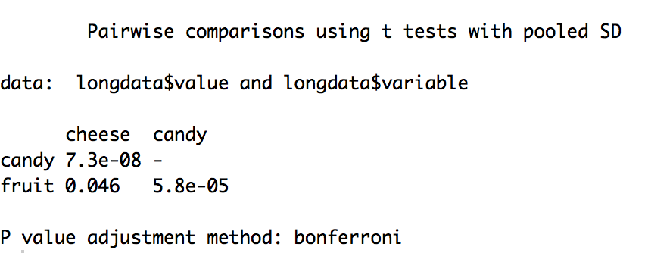
Bonferroni in R
Remember, you can turn off scientific notation with
options(scipen = 999)

Slide 57
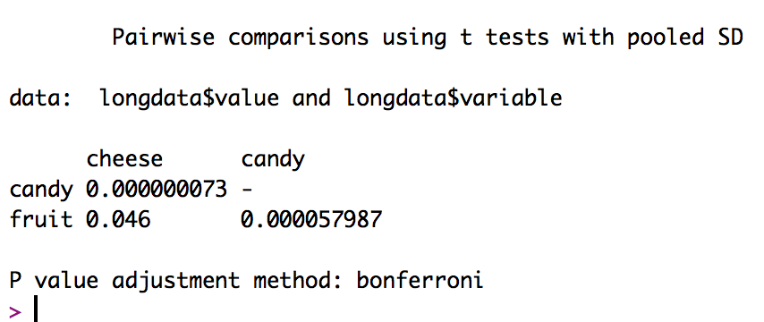
So, what do I do with this?

Slide 58
Group 1 | Group 2 | P-value | Comparison | Reject?
Cheese M = 6.3 | Candy M = 2.7
Cheese M = 6.3 | Fruit M = 5.1
Candy M = 2.7 | Fruit M = 5.1
First, fill in the group comparisons

Slide 59
Group 1 | Group 2 | P-value | Comparison | Reject?
Cheese M = 6.3 | Candy M = 2.7 | < .001
Cheese M = 6.3 | Fruit M = 5.1 | .046
Candy M = 2.7 | Fruit M = 5.1 | < .001
Then fill in the p values from the output

Slide 60
Group 1 | Group 2 | P-value | Comparison | Reject?
Cheese M = 6.3 | Candy M = 2.7 | < .001 | p < .05
Cheese M = 6.3 | Fruit M = 5.1 | .046 | p < .05
Candy M = 2.7 | Fruit M = 5.1 | < .001 | p < .05
Fill in your alpha value, remember p value is corrected already

Slide 61
Group 1 | Group 2 | P-value | Comparison | Reject?
Cheese M = 6.3 | Candy M = 2.7 | < .001 | p < .05 | YES Cheese > candy
Cheese M = 6.3 | Fruit M = 5.1 | .046 | p < .05 | YES Cheese > fruit
Candy M = 2.7 | Fruit M = 5.1 | < .001 | p < .05 | YES Fruit > candy
Decide if you want to reject or not!
Interpret!

Slide 62
Interpret!
Therefore,
Cheese > fruit > candy on ratings of healthiness for snacks.
Because cheese is the best. ☺

